Slide 1
Grad School 101

Slide 2
Why Graduate School?
Your graduate degree will
Help you get ahead in the work force
Set you apart from your competition in the job market
Foster higher earning potential
Provide personal reward and satisfaction
Notes:
A master’s degree will absolutely help you get ahead in the work force
With the market saturated with job seekers with bachelor’s degrees, the extra 2 years of schooling will help set you apart from the competition
Based on a study by the Georgetown University Center on Education and Workforce, individuals with a graduate degree can expect significantly higher career earnings across all disciplines
The personal rewards and satisfaction of earning a terminal degree are great. You become a true expert in the field where your passions lie.
Some students go straight thru and others take time and work and then go back to school or do it while working. There is no right path, just a best fit for you.
Having a masters or a PHD better prepares you for a job in a field that you love
It will open more doors
What I loved about grad school was all the courses were in a field I was interested in
There were required courses, but in the discipline I was already interested in
That impacted my motivation and enjoyment

Slide 3
Graduate School Myths
Let’s debunk some myths.
MYTH #1: “It’ll just cost me more money…”
MYTH #2: “It will limit my options…”
MYTH #3: “It’s only for students with top grades…”
MYTH #4: “It’s just more of the same…”

Slide 4
Graduate School Myths
Myth 1: It’ll just cost me more money
▶︎ You have funding options ︎
Assistantships
Teaching Assistantship (TA)
Research Assistantship (RA)
Graduate Assistantship (GA)
Tuition reduction and stipend
Fellowships
Funded by NSF, DOE, DOD, etc.
Requires excellent grades
Stipend and tuition
Allows you to go anywhere
Notes:
MYTH #1: It will cost me more money…

Slide 5
Graduate School Myths
Myth 2: It will limit my options
▶︎ Doors open for you︎
Lockheed Martin
Sr Member Eng Stf ▪︎ 5 years experience OR advanced degree
Candidate will be a key contributor to the Human Systems and Autonomy research area within Lockheed Martin Advanced Technology Laboratories, will communicate with Lockheed Martin internal and external customers to define needs and execute on research to address these needs in both the short and long term.
Work within a distributed team of scientists and engineers at ATL, other Lockheed Martin facilities, outside companies, and universities to perform research in human systems integration, human performance augmentation, and human-machine teaming, with a focus on designing and executing large-n studies of human behavior in diverse environments.
Applicants are expected to have ideas for research and have a desire to see these research concepts funded.
Research will focus on generating approaches that can be used to enhance Lockheed Martin’s goal of enabling human-system teaming and to making leaps ahead in human-system effectiveness.
R&D could take place in the areas of human-systems integration, human-robot interaction, performance monitoring, or adaptive training. Applicants selected will be subject to a government security investigation and must meet eligibility requirements for access to classified information.
Notes:
MYTH #2: It will limit my options…

Slide 6
Graduate School Myths
Myth 3: It’s only for students with top grades
► The ideal student is…
Faculty define the “ideal student” as:
Inquisitive
Hard-working
Persistent
Passionate
Open-minded
You’re evaluated for potential to succeed:
GRE — Writing, Verbal
Last few semesters demonstrated success
Research/Job experience
A real purpose to go to graduate school
Notes:
MYTH #3: It is only for students with top grades…

Slide 7
Graduate School Myths
Myth 4: It’s just more of the same…
► It’s where transformation happens
Graduate school can transform you:
You’ll become an expert in a field that you are passionate about
You’ll develop strong research skills
You’ll conduct research that makes a difference in the world
You’ll make connections, professional and personal
Notes:
MYTH #4: It is just more school…

Slide 8
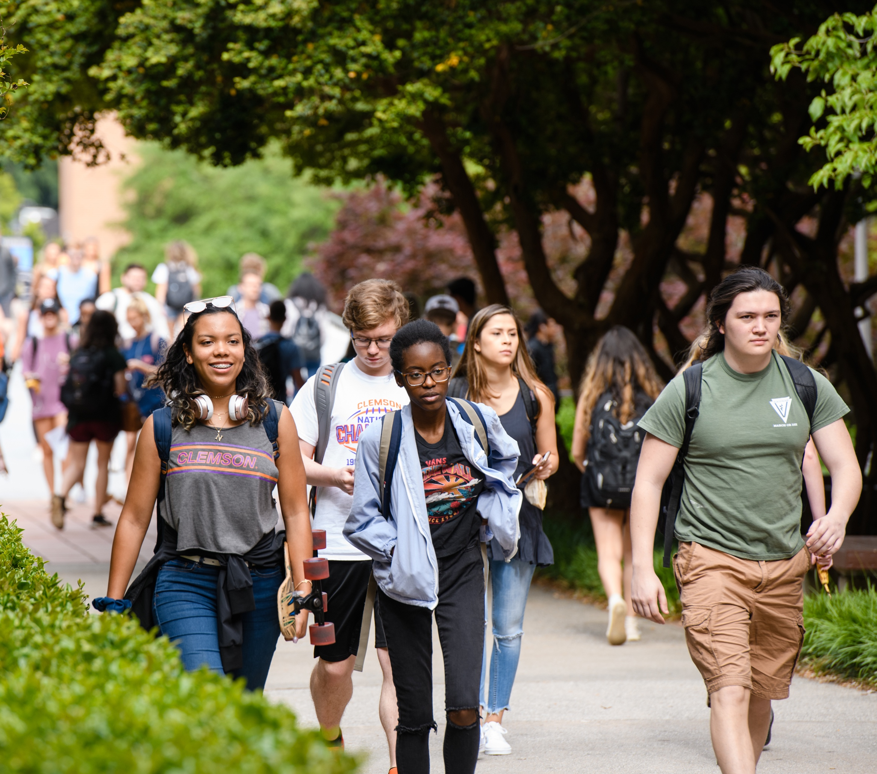
Choosing a Graduate School
Do your homework
Be realistic
6–10 programs
Conduct in-depth research
School
Program
Faculty
Notes:
Graduate School is all about research and it starts with narrowing down the school options
Consider the school’s reputation and rankings.
Consider the program’s reputation, course work-is it relevant to your goals
Consider the faculty’s reputation, previous publications and research, Are there faculty with your interest?

Slide 9
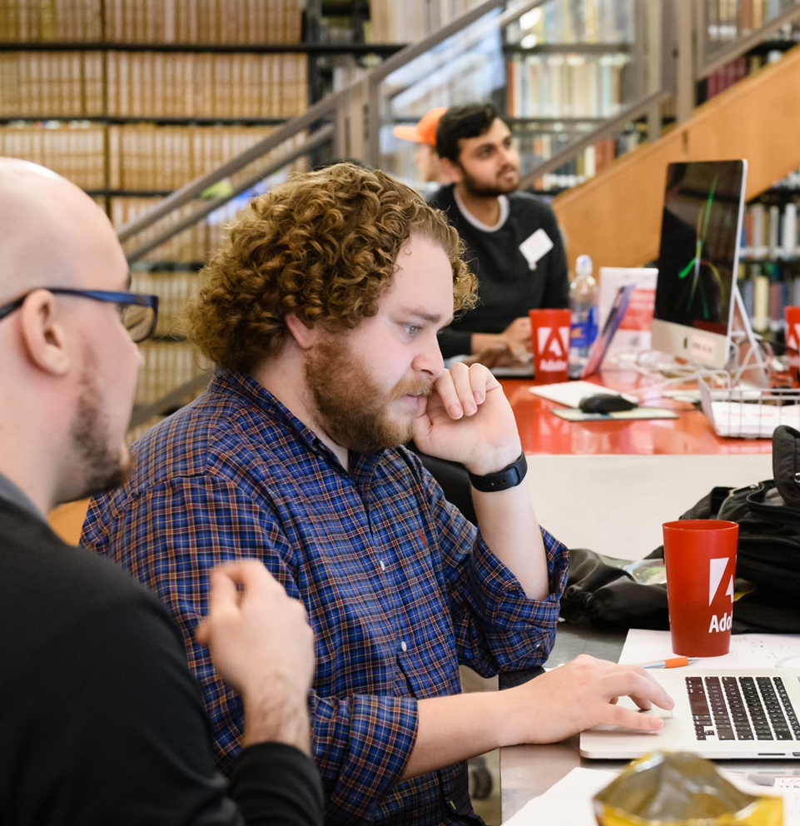
Choosing a Graduate School
Understand the program
Classes?
Graduation requirements?
How long is the program?

Slide 10
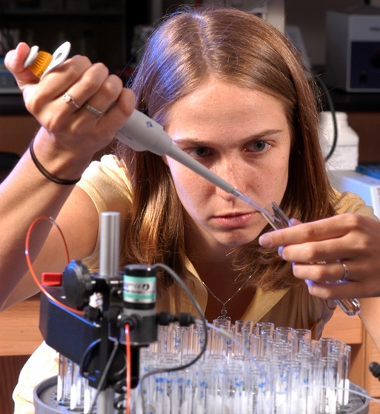
Communicating with a Graduate Program
Start multiple dialogues
Express your interest before you apply
Let them know who you are
Visit the program in person (if possible)
Identify Faculty
Do any have research interests that align with your own?
Contact 1 or 2 specific faculty members
Describe yourself
Indicate interest in their work and why
Talk to current students in the program (if possible)

Slide 11
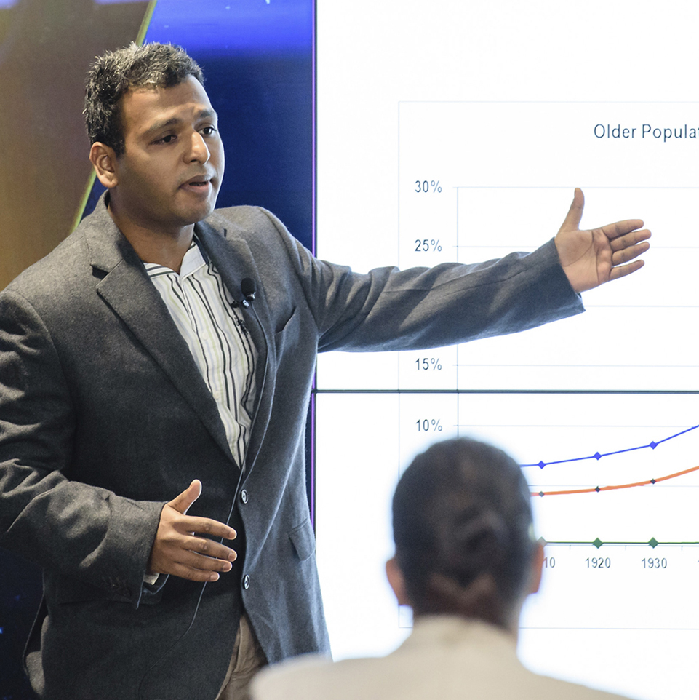
Communicating with a Graduate Program
Communication tips
Use good judgment when establishing lines of communication
Be professional
Sell yourself!
What do you bring to the table?

Slide 12
Applying to Graduate School
What is needed to apply?
Application
Transcripts
GRE or GMAT scores
English proficiency exam (international students)
TOEFL, IELTS, or PTE
Recommendations
Personal statement or statement of purpose
Curriculum Vitae (CV)
Interview

Slide 13
Applying to Graduate School
Application
Read ALL instructions
Pay attention to the deadline
Take your time

Slide 14
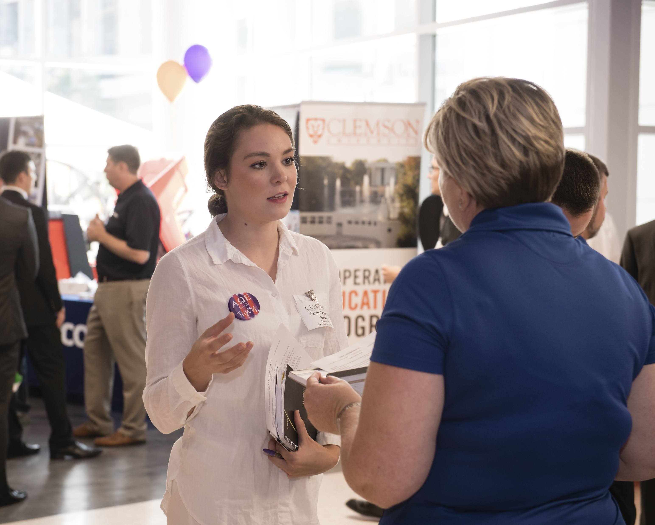
Applying to Graduate School
Transcripts
Official vs. Unofficial
Determine what is required
Major GPA vs. Overall
If your major GPA is higher than your overall, it’s not a bad idea to note that in your CV and interview

Slide 15
Applying to Graduate School
Test scores
GRE, GMAT, LSAT, MCAT, MAT…
Pay attention to what is required for your program
Is there a minimum score? Preferred range?
Utilize resources to prepare

Slide 16
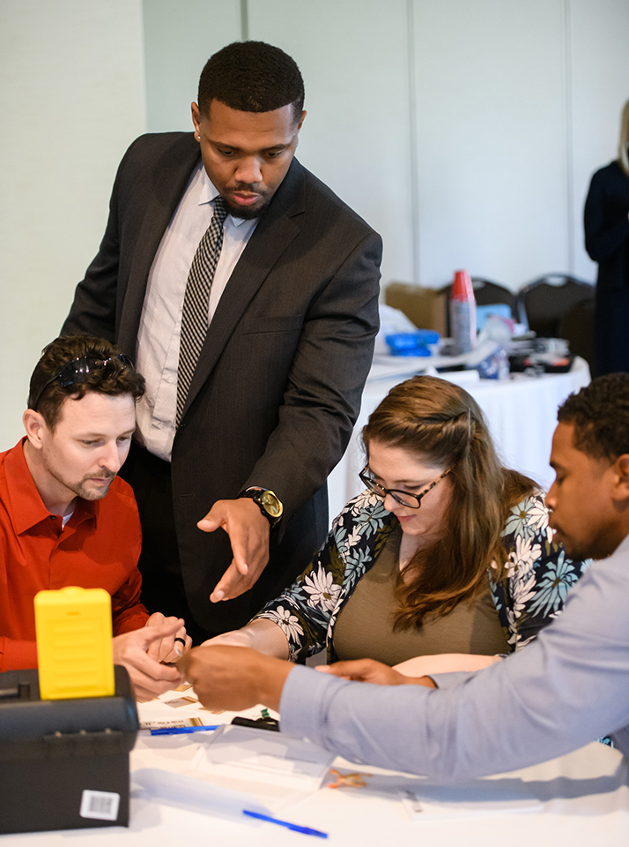
Applying to Graduate School
Recommendations
How many are needed?
Usually 2–3
Who should you ask?
Ask first!
Can they write a strong letter?
Give them enough time
Give them your CV and information about the program
Remind them
Thank them!
Notes:
LORs can help give a fuller picture of your capabilities beyond what your transcripts and test scores may demonstrate

Slide 17
Applying to Graduate School
Personal statement or statement of purpose
Prepare an excellent essay
Opportunity to sell yourself to the program
Show that you + program = good match
Follow instructions
Address the questions provided
Keep to page limit provided
What do they want you to address?
Why you want to pursue the program
What are your research interests
How are you a good fit for the program
Address any shortcomings in your transcripts, GPA, or test scores
Demonstrate good communication skills
Write it yourself, but get feedback

Slide 18
Applying to Graduate School
Curriculum vitae (academic resumé)
Includes:
Schools you have attended
Degree or degrees you have earned
Achievements you have accomplished
Awards and recognitions
Publications
Research and work experience
Organizations you were a member of
Use a professional font
Sell yourself!

Slide 19
Applying to Graduate School
Interview
Opportunity to set yourself apart
Be prepared to talk about why you want to pursue the program, long term goals, why this school, research interests, and experiences that prepare you for the program
Know the program
Have questions
Be yourself ! It’s a conversation

Slide 20
Applying to Graduate School
Online interview
Practice by Skyping a friend
Be conscious of your background
Choose in a quiet place with good internet
Dress for the camera

Slide 21
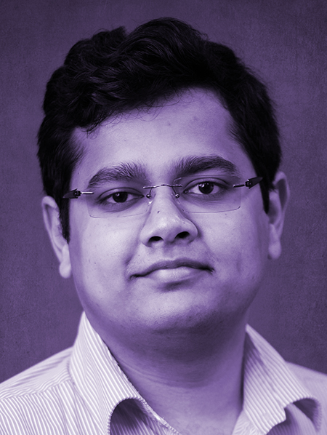
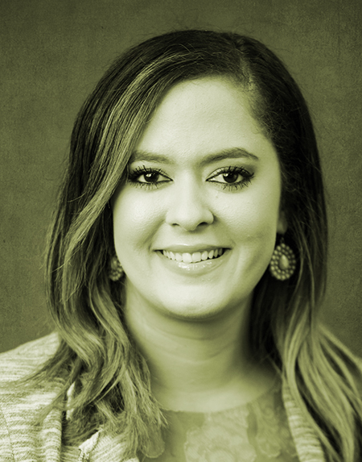
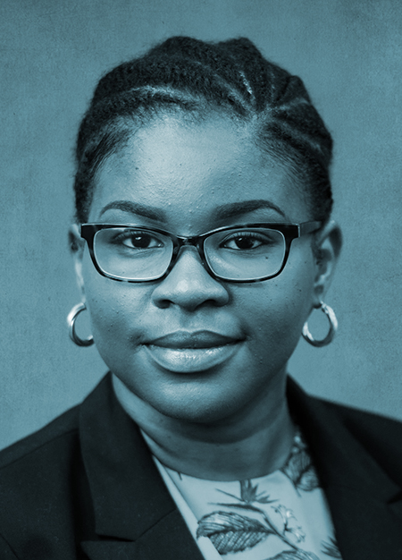
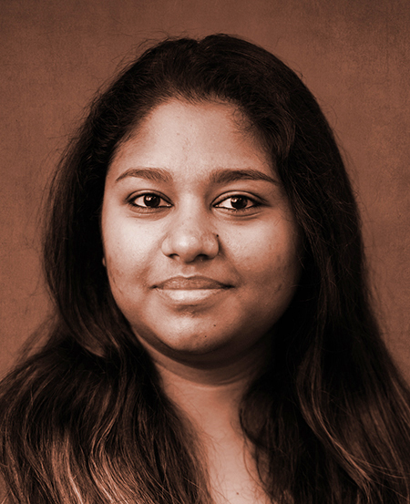
Applying to Graduate School
In-person interview
Shake hands
Smile — and mean it!
Be polite
Sit up straight
Look at the interviewer
Provide brief, direct answers
Say “thank you”

Slide 22
Applying to Graduate School
The interview — some things to remember…
You will always be “on”
You were selected to be there
This is a chance to provide and get information

Slide 23
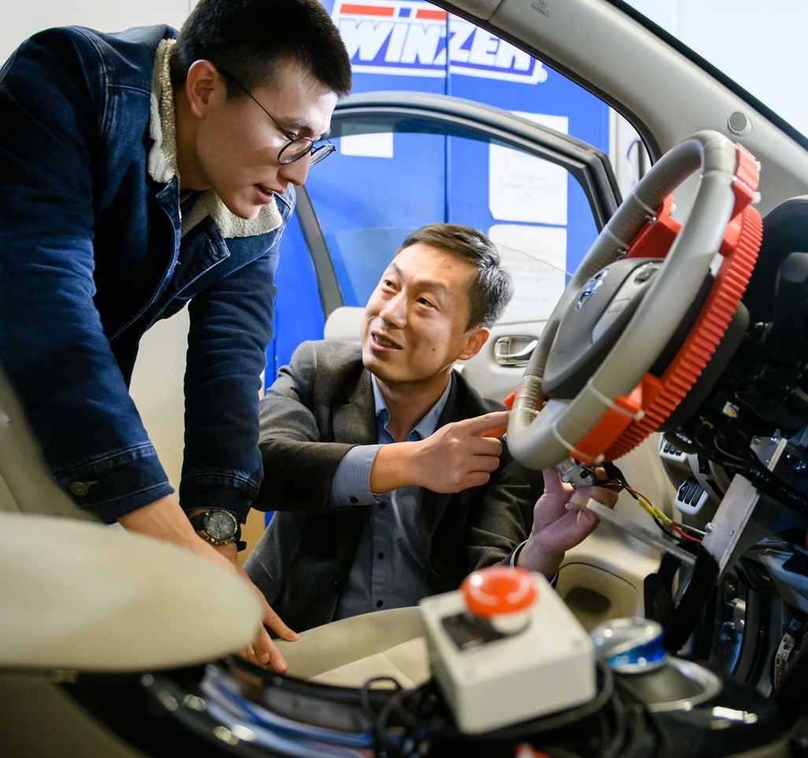
Preparing for Graduate School Now
Experience matter
Co-ops, internships
Summer research
Study abroad
Undergraduate research experiences

Slide 24
Preparing for Graduate School Now
Assess your strengths/weaknesses
Improve your record
courses
research
communication skills
social skills
Establish a group of mentors
to provide feedback
to give advice
to write letters of recommendation

Slide 25
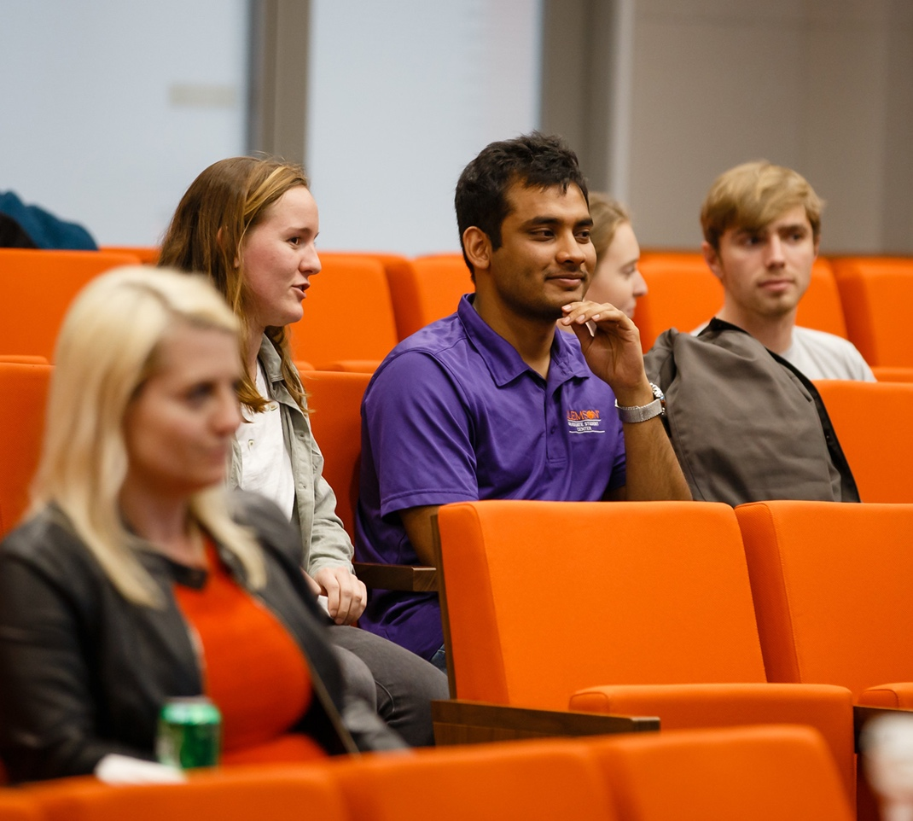
Preparing for Graduate School Now
Think about your goals
Meet with your advisor
Get involved
Utilize resources
Build relationships
Notes:
-When I work with students I have them write down every year, what they want to be doing in 3 years. Then I ask them to consider what it will take to achieve that goal.
-If grad school is what it will take to reach your goals then do your research, ask questions.
-Academic Advisor- they have experience helping students succeed. They are there to help you. Let them know you are interested in grad school.
-There are so many organizations and opportunities here at Clemson. Take advantage of them. Get involved in research opportunities like creative inquiry or REU’s (research experience for undergraduates), study abroad, do internships and co-ops.
-All of these things will be great as you start building your resume. Resume’s are usually apart of the application process.
-Utilize Resources – for example the career services here is one of the top in the country. They can help you with your resume or to find internships or co-op opportunities. Academic Success Center and tutors and mentoring programs to make sure you are succeeding inside the classroom and getting good grades and succeeding her at Clemson.
-Build relationships- your faculty, staff, TA’s are great people to connect with. Pick their brains. They could help you get connected, achieve your goals and they could very well be the ones to write a letter of recommendation for you.

Slide 26
Consider Clemson!

Slide 27
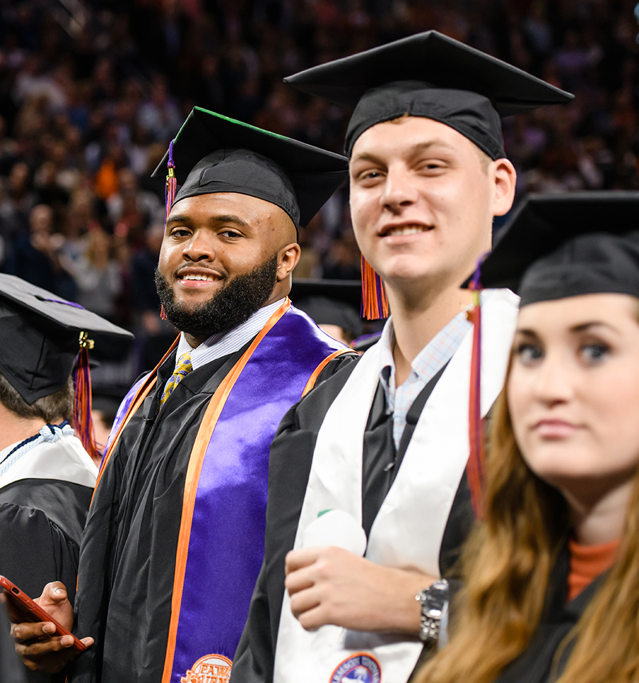
Consider Clemson!
Carnegie Tier 1 Research University
More than 140 graduate programs
Our graduate students consistently rate Clemson faculty as “excellent”
Clemson offers a growing, inclusive and vibrant graduate student community
Notes:
Clemson is one of the nation's top 25 public research universities. For our graduate students that means access to tremendous opportunities for research and professional engagement.
Clemson offers 140+ graduate programs.
Our graduate students consistently rate Clemson faculty as "excellent."
Clemson offers a growing, inclusive and vibrant graduate student community.

Slide 28
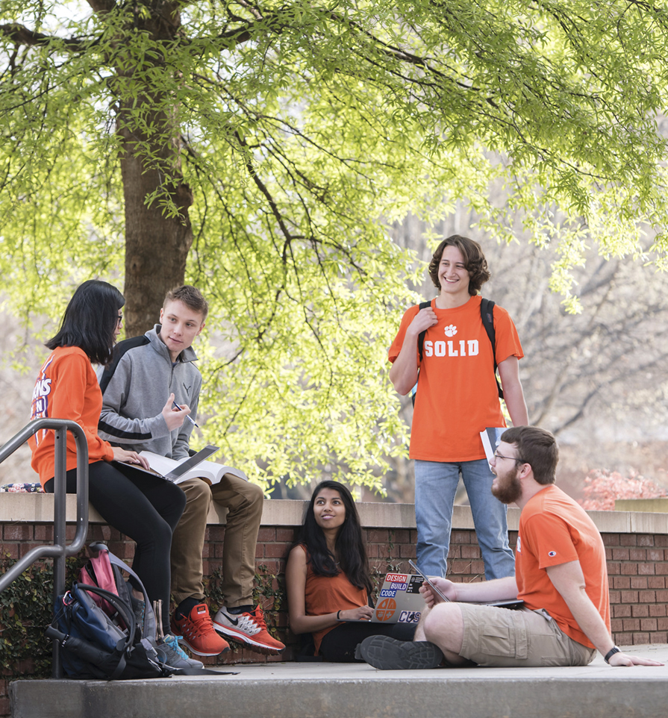
Consider Clemson!
Ranked in the top ten in the nation for:
Students love their university (#1)
Safest campus (#1)
Best career services (#2)
Alumni give back to the university (#3)
Supercomputing power at universities (#4)
Outstanding town-gown relations (#6)
Happiest students (#7)

